Slide 1

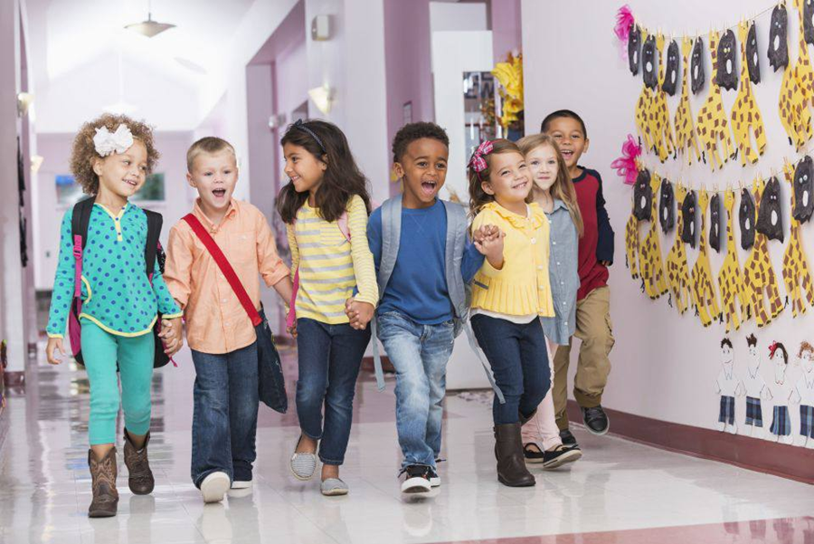
University of Basra College of Nursing
Preschooler Stage
Sixth Lecture
Prepared by:- assist Lect. Noor Salah Shreef

Slide 2
Preschooler Stage
Preschoolers are children who are 3 to 6 years of age. This time period is a stage of preschoolers that will go through many changes in his physical mental, emotional and social development. The growth during this period is relatively slow.
The Child Growth
1. Physical growth
• Weight: The preschool period is one of slow growth. The child gains about each year (1.8 kg).
• Height: Yearly gain 5-7 cm (Birth length doubles by age 4- 5 Years).
• Has all 20 primary teeth by age 3. Toward the end of the preschool stage, these teeth begin to be replaced by permanent teeth.
• Sleeps 11 to 13 hours at night, most often without a daytime nap.
• Boys tend to be leaner than girls are during this time.

Slide 3
2. Physiological growth
pulse rate: 80 to 120 beat per minute.
Respiratory rate: 20 to 30 breaths per minutes.
Blood pressure: systolic 89 to 112, diastolic 46 to 72.
Arms and legs become longer in relation to their torso
Becomes thinner
Improved ability to hop, skip, catch and throw and balance on one foot
Can feed themselves
Can draw somewhat realistic picture
3. Psychosocial Development
Preschool age is characteristic of rapid language development. Imagination, sexual and social development and a variety of types of play also characterize the preschool child's psychosocial development.

Slide 4
PHYSICAL DEVELOPMENT
Growth is slow and gradual.
Appetites are small.
Nutrition is especially important.
Children begin to lose baby like features.
Heart rate slows and steadies
Blood pressure increases
Digestive tract matures, lags behind other organs

Slide 5
Motor Development
Small and large motor skills are refined and complex.
Preschoolers master greater control of their bodies.
Activities and skills include;-
running, galloping, hopping, and climbing.
balance beam.
Standing on one foot – static
ball throwing.
swaying to music; learning rhythms and dances.
bicycle riding. – dynamic

Slide 6
FINE-MOTOR DEVELOPMENT
3 year olds | 4 year olds | 5 year olds
Builds uneven tower of blocks | Cuts on line with scissors | Folds paper along the diagonal
Pours water from a pitcher | Washes hands | Copies a square and a triangle
Copies a circle | Copies a letter | Traces a diamond shape
Draws a straight line | Makes a few letters | Laces shoes and may tie them

Slide 7
Psychoanalysis
1. Psychosocial
Erikson- (initiative vs. guilt) Success in this stage involves initiative, Where he wants to learn what to do for himself, learn about the world And other people. When he fail he develop sense of guilt.
Can understand and follow rules
Have a sense of right and wrong
Want to avoid punishment and gain rewards
Express feelings
Need to develop positive feelings about themselves
May have fears, such as of the dark
2. Psychosexual
Freud- (Phallic stage) the focus of this stage is pleasure derived from the genitals; childhood masturbation is common and exploration of the child for the genital.

Slide 8
3. Cognitive development
Preschooler up to 4 years of age is in the pre-conceptual phase.
He begins to be able to give reasons for his belief and actions,
but not true cause-effect relationship.
Ask “who, what and where” questions about their Environment
Use short sentences to carry on a conversation
Begin to learn about reading, writing and following directions
Can concentrate on a task

Slide 9
4- Social Development
Egocentric
Tolerates short separation
Less dependent on parents
May have dreams & night-mares
Attachment to opposite sex parent
More cooperative in play

Slide 10
Play and Playing:
Play activities are one way that children team. Normally by3 years of age, children begin imitative play, pretending to be the mommy, the daddy, a policeman, a cowboy, an astronaut, or some well-known person or television character.
Preschoolers engage in various types of play dramatic, cooperative, associative, solitary independent' onlooker, and unoccupied behavior.

Slide 11
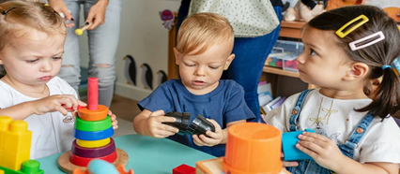
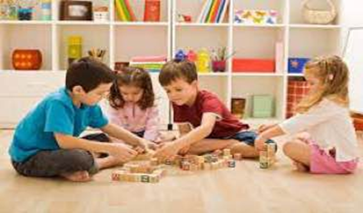
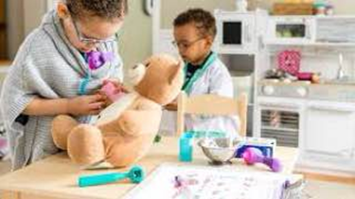
Dramatic play, allows a child to act out troubling situations and to control the solution to the problem. This is important to remember when teaching children who are going to be hospitalized. Using dolls and puppets to explain Procedures makes the experience less threatening.
Cooperative play, children play in an organized group with each other as in team sports.
Associative play occurs when children play together and are engaged in a similar activity but without organization, rules, or a leader, and each child does what she or he wishes.

Slide 12
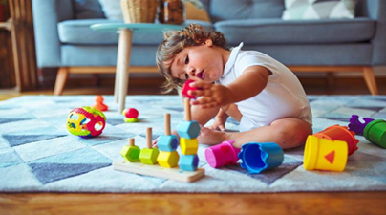
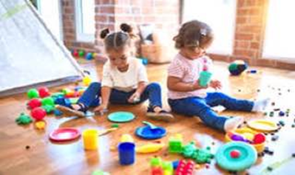
In parallel play, children play alongside each other but independently.
Solitary independent play means playing apart from others without making an effort to be part of the group or group activity.
Watching television is one form of onlooker play in which there is observation without participation.
In unoccupied behavior, the child may be daydreaming or fingering clothing or a toy without apparent purpose.

Slide 13
Language Development
- Between the ages of 3 and 5 years, language development is generally rapid. Most 3-year-old children can construct simple sentences, but their speech has many hesitations and repetitions as they search for the right word or try to make the right sound.
- Stuttering develop during this period but usually disappears within 3 to 6 months. By the end of the 5th year, preschoolers use long, rather complex sentences their vocabulary will have increased by more than 1,500 words since the age of 2.

Slide 14
Preschoolers Nutrition
The preschool period is not a time of rapid growth, so children do not need large quantities of food.
- A preschooler's daily caloric requirement is 90 kcal / kg or about1800 kcal / day.
- Daily fluid intake should average 100 ml/kg, depending on activity level.

Slide 15
Preschooler Needs
Love and security
Healthy nutrition
Sleep ,rest and quit environment
Playing
Learning language
Routine health examination (visual ,auditory screening test)

Slide 16
Developmental Problems
1. Bad Language.
2. Jealousy- Selfishness
3. Thumb Sucking.
4. Food like & dislike.
5. Enuresis.
6. Destructiveness.
7. Hurting others.

Slide 17
COMMON PRESCHOOLERS ACCIDENTS AND INJURIES
Motor accident
Drowning
Falls
Burn
Injury by sharp instruments or play contact
Suffocation
Poisoning

Slide 18
PRESCHOOLERS CARE GIVING GUIDELINES
Build motor skills by providing water play, encouraging running, skipping, playing catch and with games like hide and seek and Simon Says.
Do simple crafts, storytelling, use puppets and play dress up.
Encourage the child to talk about their activities, artwork and feelings about their friends and family.
Provide puzzles, cutting and coloring activities.
Assign household tasks and help the child to successfully complete the task.
Talk with the child about their everyday activities and feelings, encouraging their questions .

Slide 19
SUMMARY OF NURSING INTERVENTIONS
Encourage parents to be involved in care of child.
Provide safe versions of medical equipment for playtime.
Give clear explanations about procedures and illnesses.

Slide 20
SUMMARY OF DEVELOPMENT MILESTONES
Uses scissors.
Rides bicycle with training wheels.
Throws a ball.
Writes a few letters.
All parts of speech well-developed.

Slide 21


